Slide 1

Blockchain
Sunitha R
Department of Computer Science and Engineering

Slide 2

Blockchain
HYPERLEDGER FABRIC
Sunitha R
Department of Computer Science and Engineering

Slide 3
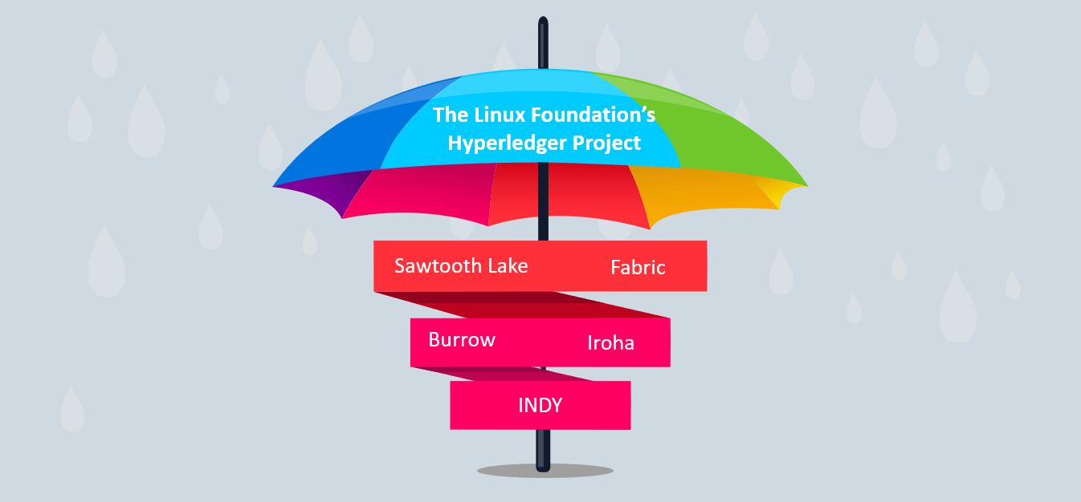
Blockchain
Hyperledger
The Linux Foundation founded the Hyperledger project in 2015 to advance cross-industry blockchain technologies.
Hyperledger Fabric is one of the blockchain projects within Hyperledger. Like other blockchain technologies, it has a ledger, uses smart contracts, and is a system by which participants manage their transactions.
Rather than an open permissionless system that allows unknown identities to participate in the network, the members of a Hyperledger Fabric network enroll through a trusted Membership Service Provider (MSP).

Slide 4
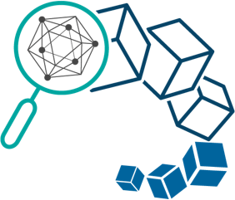
Blockchain
Hyperledger Fabric
Hyperledger is an enterprise-grade, open-source distributed ledger framework launched by the Linux Foundation in December 2015.
Fabric is a highly-modular, decentralized ledger technology (DLT) platform that was designed by IBM for industrial enterprise use.
Because Hyperledger Fabric is private and requires permission to access, businesses can segregate information (like prices), plus transactions can be sped up because the number of nodes on the network is reduced.
Fabric 2.0 was released in January 2020. The main features of this version are faster transactions, updated smart contract technology, and streamlined data sharing.

Slide 5
Blockchain
Hyperledger Fabric Model
The key design features woven into Hyperledger Fabric that fulfill its comprehensive, yet customizable, enterprise blockchain solution:
Assets
Chaincode
Ledger Features
Privacy
Security & Membership Services
Consensus

Slide 6






Blockchain
Transaction Flow
Hyperledger separates transaction flow in three distinct steps:
Transaction Execution – running the smart contract code
Ordering through a consensus protocol
Transaction Validation
Endorse
Order
Validate

Slide 7
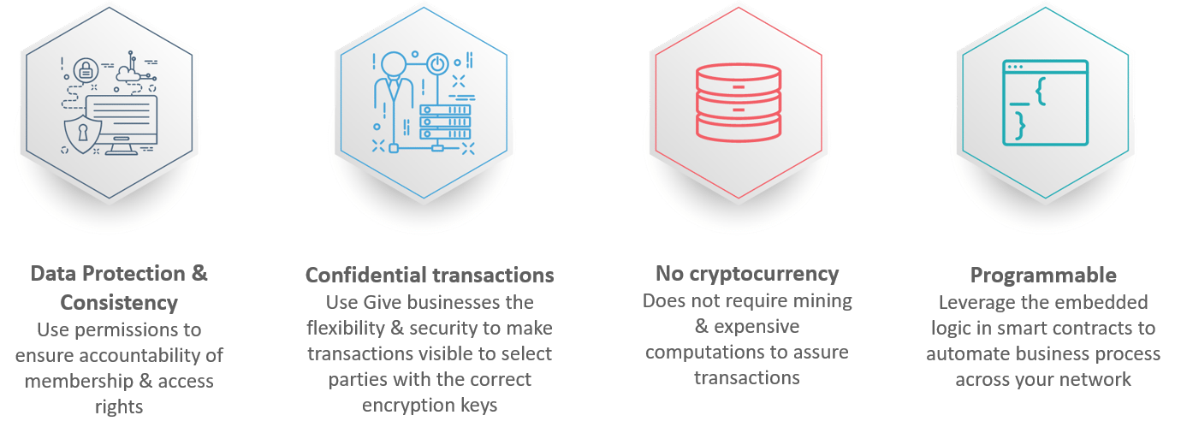
Blockchain
Key Benefits of Hyperledger Fabric

Slide 8
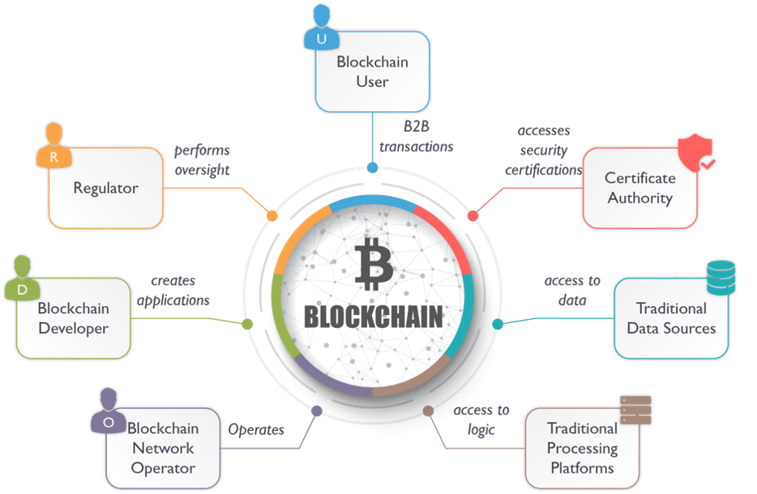
Blockchain
Participants of Hyperledger Fabric

Slide 9
Blockchain
SUPPLEMENTARY READINGS
https://hyperledger-fabric.readthedocs.io/en/release-2.2/network/network.html
https://www.hyperledger.org/
https://www.ibm.com/blockchain/hyperledger

Slide 10
THANK YOU
Prof.Sunitha R
Department of Computer Science and Engineering
sunithar@pes.edu

